Slide 1
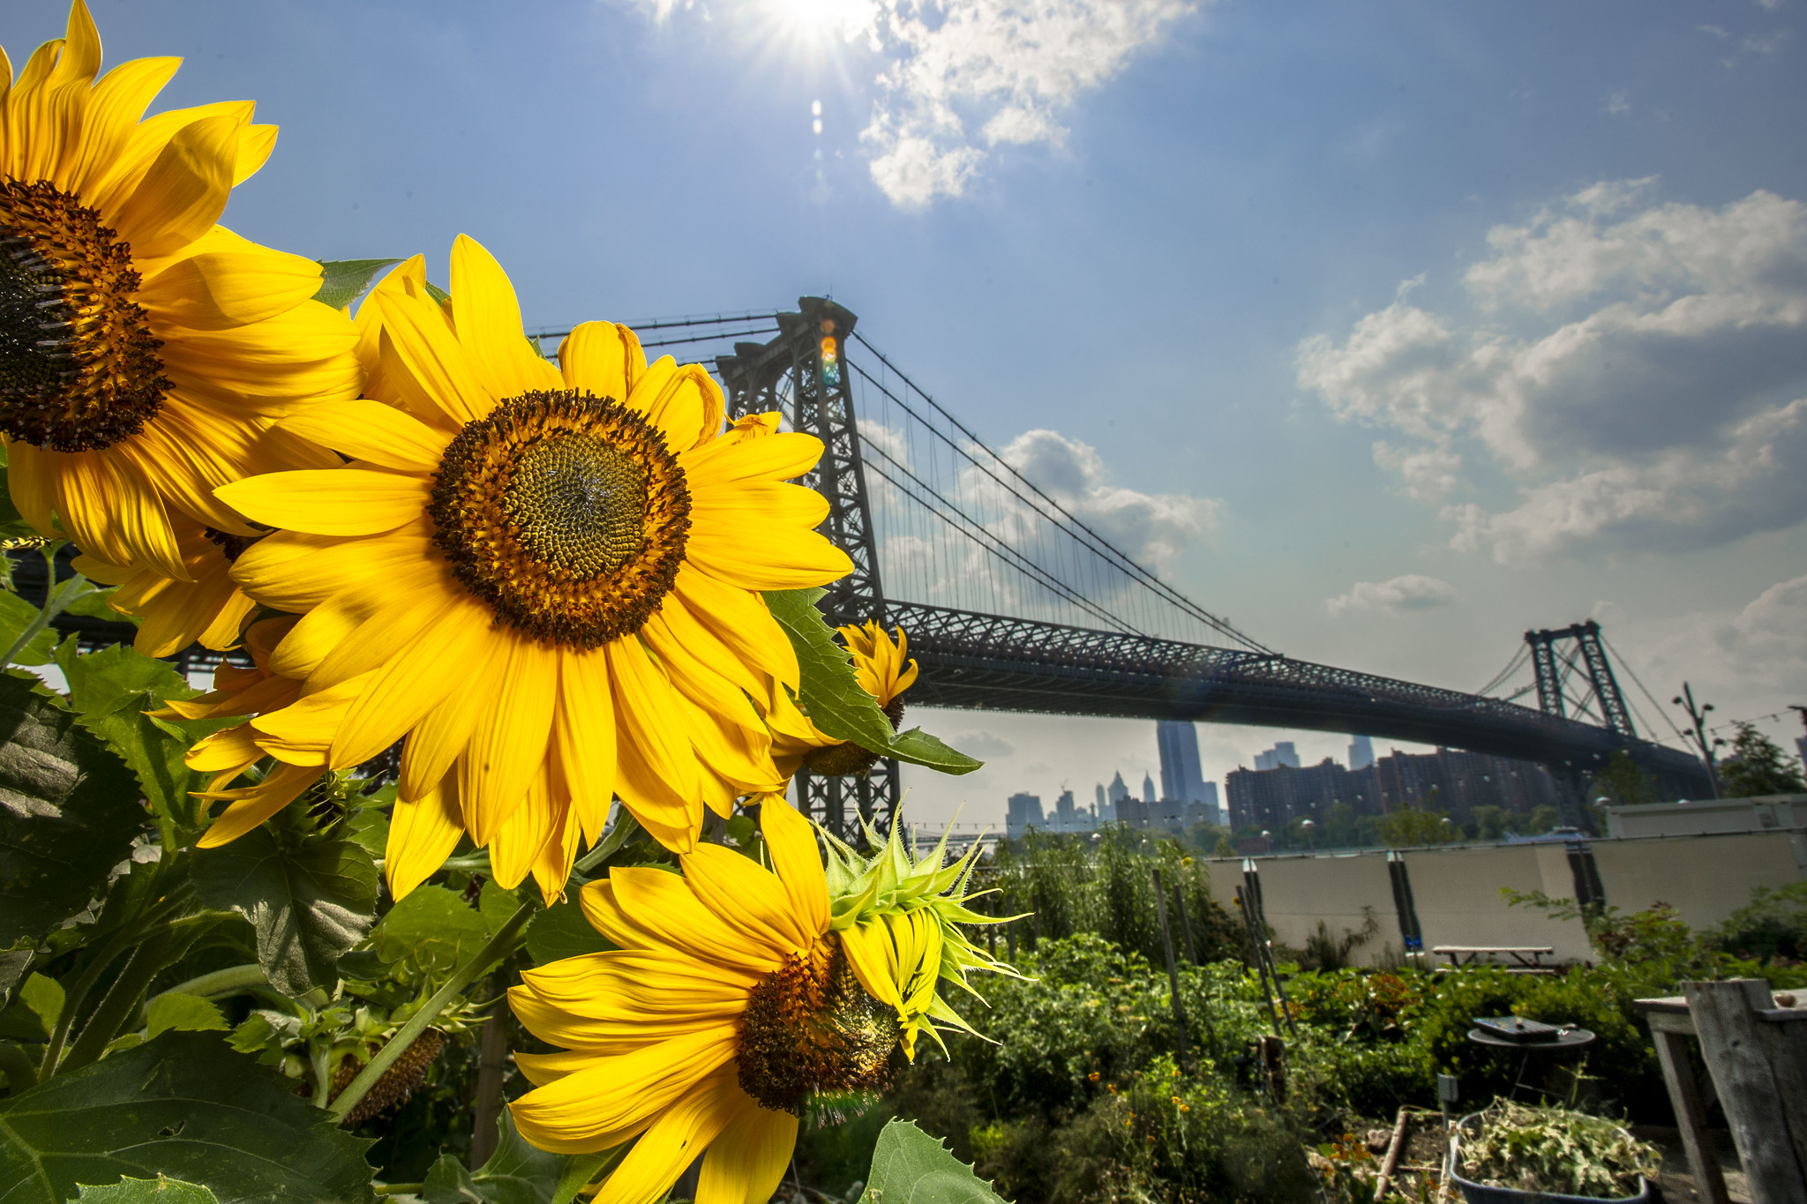
MODULE 7:
Maximize Diversity
Notes:
This module will look at strategies for incorporating biological diversity to improve soil health in small-scale agriculture systems. We will focus on understanding the principles of applying crop rotations to divers small-scale vegetable systems. We will also look at utilizing some conservation practices focused on perennial plants to increase diversity and improve soil health.
This module is interactive and contains several discussion questions and a group activity.
Photo: USDA flick

Slide 2
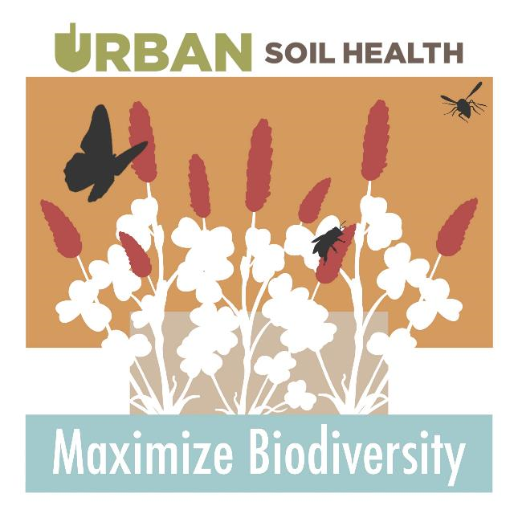
Objectives
Apply crop rotation principles to small-scale vegetable production systems.
Utilize conservation crop rotations to effectively address resource concerns in urban and small-scale agriculture.
Describe the potential benefits to soil health and ecological processes that can be achieved by incorporating diverse perennial plantings in small-scale and urban agricultural landscapes.
Notes:
Go through objectives. This is a good summary of this presentation.
Image: courtesy of Indiana Urban Soil Health Program.

Slide 3
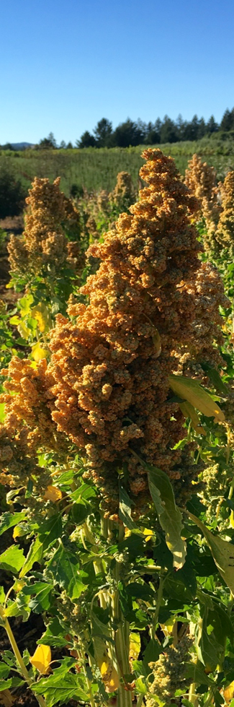
What is a crop rotation?
Conservation Crop Rotation
(CPS 328)
Definition
A planned sequence of crops grown on the same ground over a period of time (i.e. the rotation).
Notes:
Start this slide by asking the group the question – What is a crop rotation? How do they define crop rotation?
Take a few responses and discuss. It’s a good question to thing about.
In NRCS, our focus with crop rotations is CPS 328 Conservation Crop Rotation.
The definition provided on the slide is a nice, concise definition of a crop rotation. The definition was taken directly from the conservation practice standard.
Photo: Josh Beniston, USDA NRCS. A mature seed head on a quinoa (Chenopodium quinoa) plant.

Slide 4
What is a crop rotation?
What percentage of the small-scale and urban producers that you interact with follow a crop rotation?
How often do you encounter producers who would benefit from technical assistance related to conservation crop rotation?
Notes:
More questions to discuss with the group. Ask these questions one at a time and take a few responses and discuss each in turn.
First question – ask, discuss, also clarify if there are differences in crop rotation utilization/adoption between urban producers and small-scale market farms.
Second question – How often to they encounter producers who need TA related to crop rotation? ALSO, how often do they encounter NRCS staff who need additional training related to crop rotations ?

Slide 5
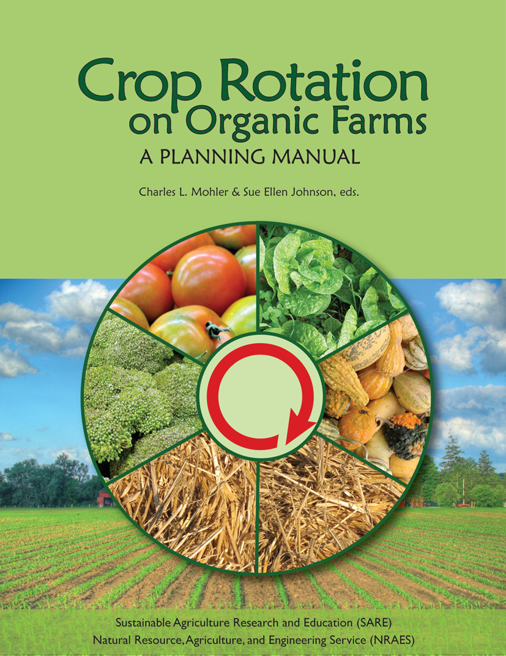
What are some common goals for crop rotations?
Maintain (or improve) soil health
Control diseases, especially soil borne pathogens
Manage weed pressure
Increase profitability
Reduce labor
Minimize off farm inputs
Maintain biological diversity
Manage farm as a whole system.
Notes:
Start this slide with question and discussion also – What are some common goals for crop rotation?
Take several responses and discuss. The go one by one through the list on the slide. This is a good list, but there may be other reasons why producers use rotations.
The list is taken from the book shown on the slide “Crop rotation on organic farms: A planning manual”. This book was written with information from a number of experienced farmers in the Northeastern U.S. and it is an excellent place to learn more about crop rotations. The book is published by USDA Sustainable Agriculture Research and Education (SARE) and a pdf version is available for free online. Highly recommended as a resource!
https://www.sare.org/resources/crop-rotation-on-organic-farms/

Slide 6
Are crop rotations common in urban and small-scale agriculture?
Very common for small-scale vegetable production farms.
Required for organic certification.
Research on urban gardens

Slide 7
Crop Rotations on Small Farms
What are some limitations that producers face when implementing crop rotations and crop diversity on small-scale farms and urban gardens?
Notes:
Ask the question and take some responses and discussion. The question is meant to address physical, logistic, economic, etc. limitations.

Slide 8
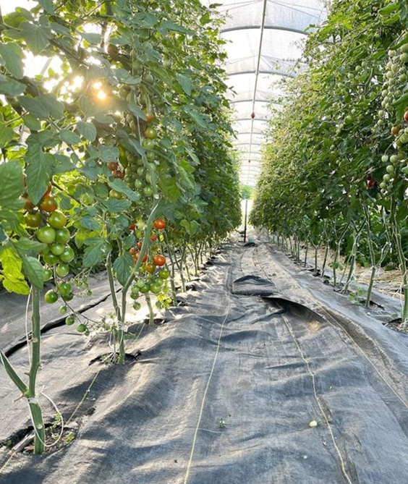
Limitations of Small Farm Crop Diversity
Need to focus on high value crops
Limited space
Not diverse root systems
Not using cover crops
Not very diverse cultivation techniques
  Bed prep, weeding, etc.
Notes:
These bullet points are a sampling of some of the limits that small-scale producers may face when thinking about diversifying their crop rotations.
The image is of tomato production in high tunnels. This is a classic example of a rotation that is very challenging to change or add diversity too. High tunnel tomatoes are very productive and likely generate large amounts of revenue on small farms that produce them. So, producers often grow tomatoes year after year in their tunnels during the warm season, because to change that crop likely means a loss in revenue.
Slide contents and image courtesy of Indiana Urban Soil Health Program.

Slide 9
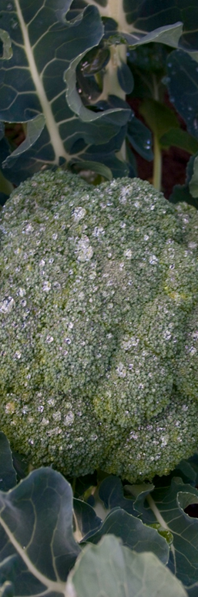
Principles For Developing a Crop Rotation
Avoid planting the same crop family in the same field too often.
Alternating heavy feeder families with light feeder families
Alternate cover crops with cash crops.
Alternate deep-rooted crops with shallow fine-rooted crops.
Precede heavy feeder crops with nitrogen fixing cover crops.
Avoid following a root crop with another root crop.
Notes:
Begin this slide by asking the question – What are some principles that can be used to guide the design of crop rotations? Or What are some principles that crop rotations should be based on ?’
Take some responses and discuss.
The slide has several good principles for crop rotations. Probably the most important principle is the first one listed here – rotating crops according to the botanical family.
We will discuss the idea of heavy feeders and light feeders in a future slide.
Photo: courtesy of Sustainable Agriculture Program, Santa Rosa Junior College.

Slide 10
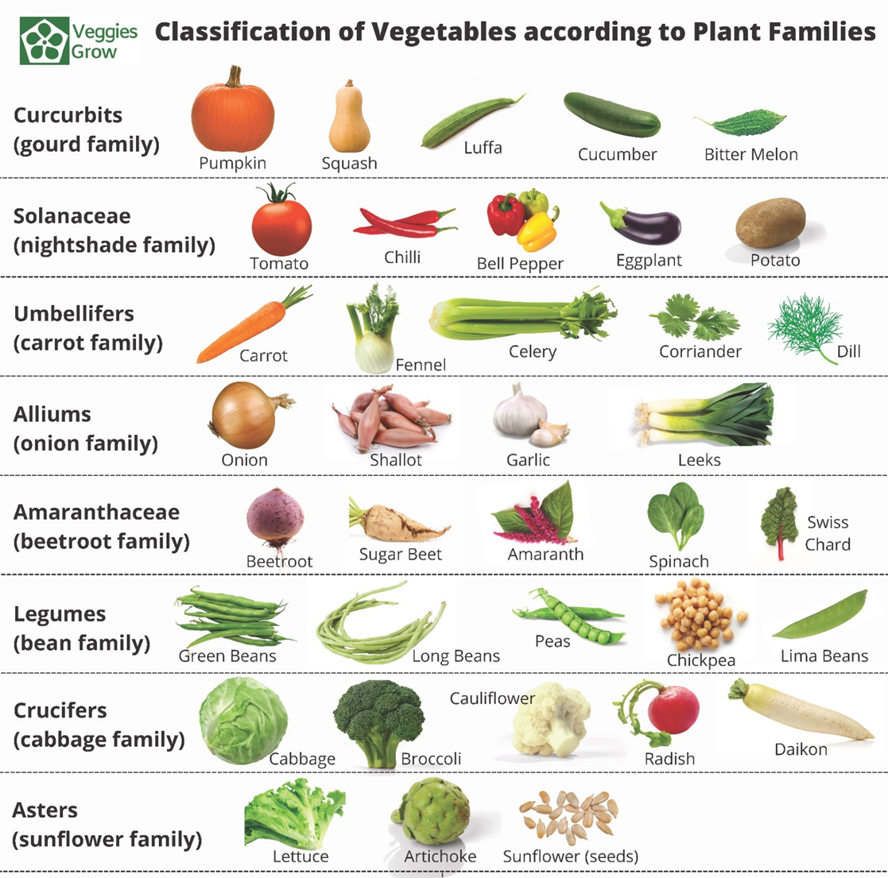
Vegetable Crop Families
Notes:
This diagram shows the botanical or plant families for several common vegetable crops.
Ask participants if anything on this diagram is surprising or confusing.
Image from: veggiesgrow.com

Slide 11
Vegetable Crop Families
Heavy Feeders:
  Require more nutrients for production.
  Susceptibility to soil-borne diseases
  Require a break in planting in same location (4 years often recommended)
    Solanaceae
    Cucurbitaceae
    Brassicaceae
    Amaryllidaceae
Light Feeders:
  Require less nutrients for production.
  Good to move annually, but longer break generally not recommended
Notes:
For vegetable growing specifically, a framework for designing crop rotations that has become popular is to alternate crop families that are considered “heavy feeders” with crop families that are considered to by “light feeders”. The bullet points here provide an explanation of heavy feeders and light feeders.
One of the key points on using this framework for crop rotations is that vegetables from heavy feeding families need a significant time/break between planting in the same location, and that is because crops in those families are very susceptible to soil-borne diseases if they are grown repeatedly in the same location.
The families listed here are the four that are most often discussed as heavy feeders. Can ask participants if they remember which crops belong to those families (we will go through them in next slide).
Many producers will often take a lot more liberty with growing crops from the families considered light feeders in the same location, including multiple crops during the same growing season, as some of those crops (ex. Lettuce) produce a harvest in a relatively short amount of time.
Sometimes need to remove all residue with vegetable for IPM
Utilize compost, mulch and amendments to replace carbon that is removed.

Slide 12
Vegetable Crop Families
Heavy Feeders
Heavy Feeders
Heavy Feeders
Heavy Feeders
Notes:
Breakdown of the plant families that are considered “heavy feeding” vegetable crops.
Again, the distinction with heavy feeder crop families is that they: (1) have higher (or heavier) nutrient requirements; (2) have higher susceptibility to soil-borne diseases, and (3) require a longer time interval between planting in the same location – primarily to reduce the risk of soil-borne disease.

Slide 13
Vegetable Crop Families
Heavy Feeders
Heavy Feeders
Light Feeders
Heavy Feeders
Light Feeders
Light Feeders
Heavy Feeders
Light Feeders
Notes:
Now labeling the crop families that are considered “light feeders”

Slide 14
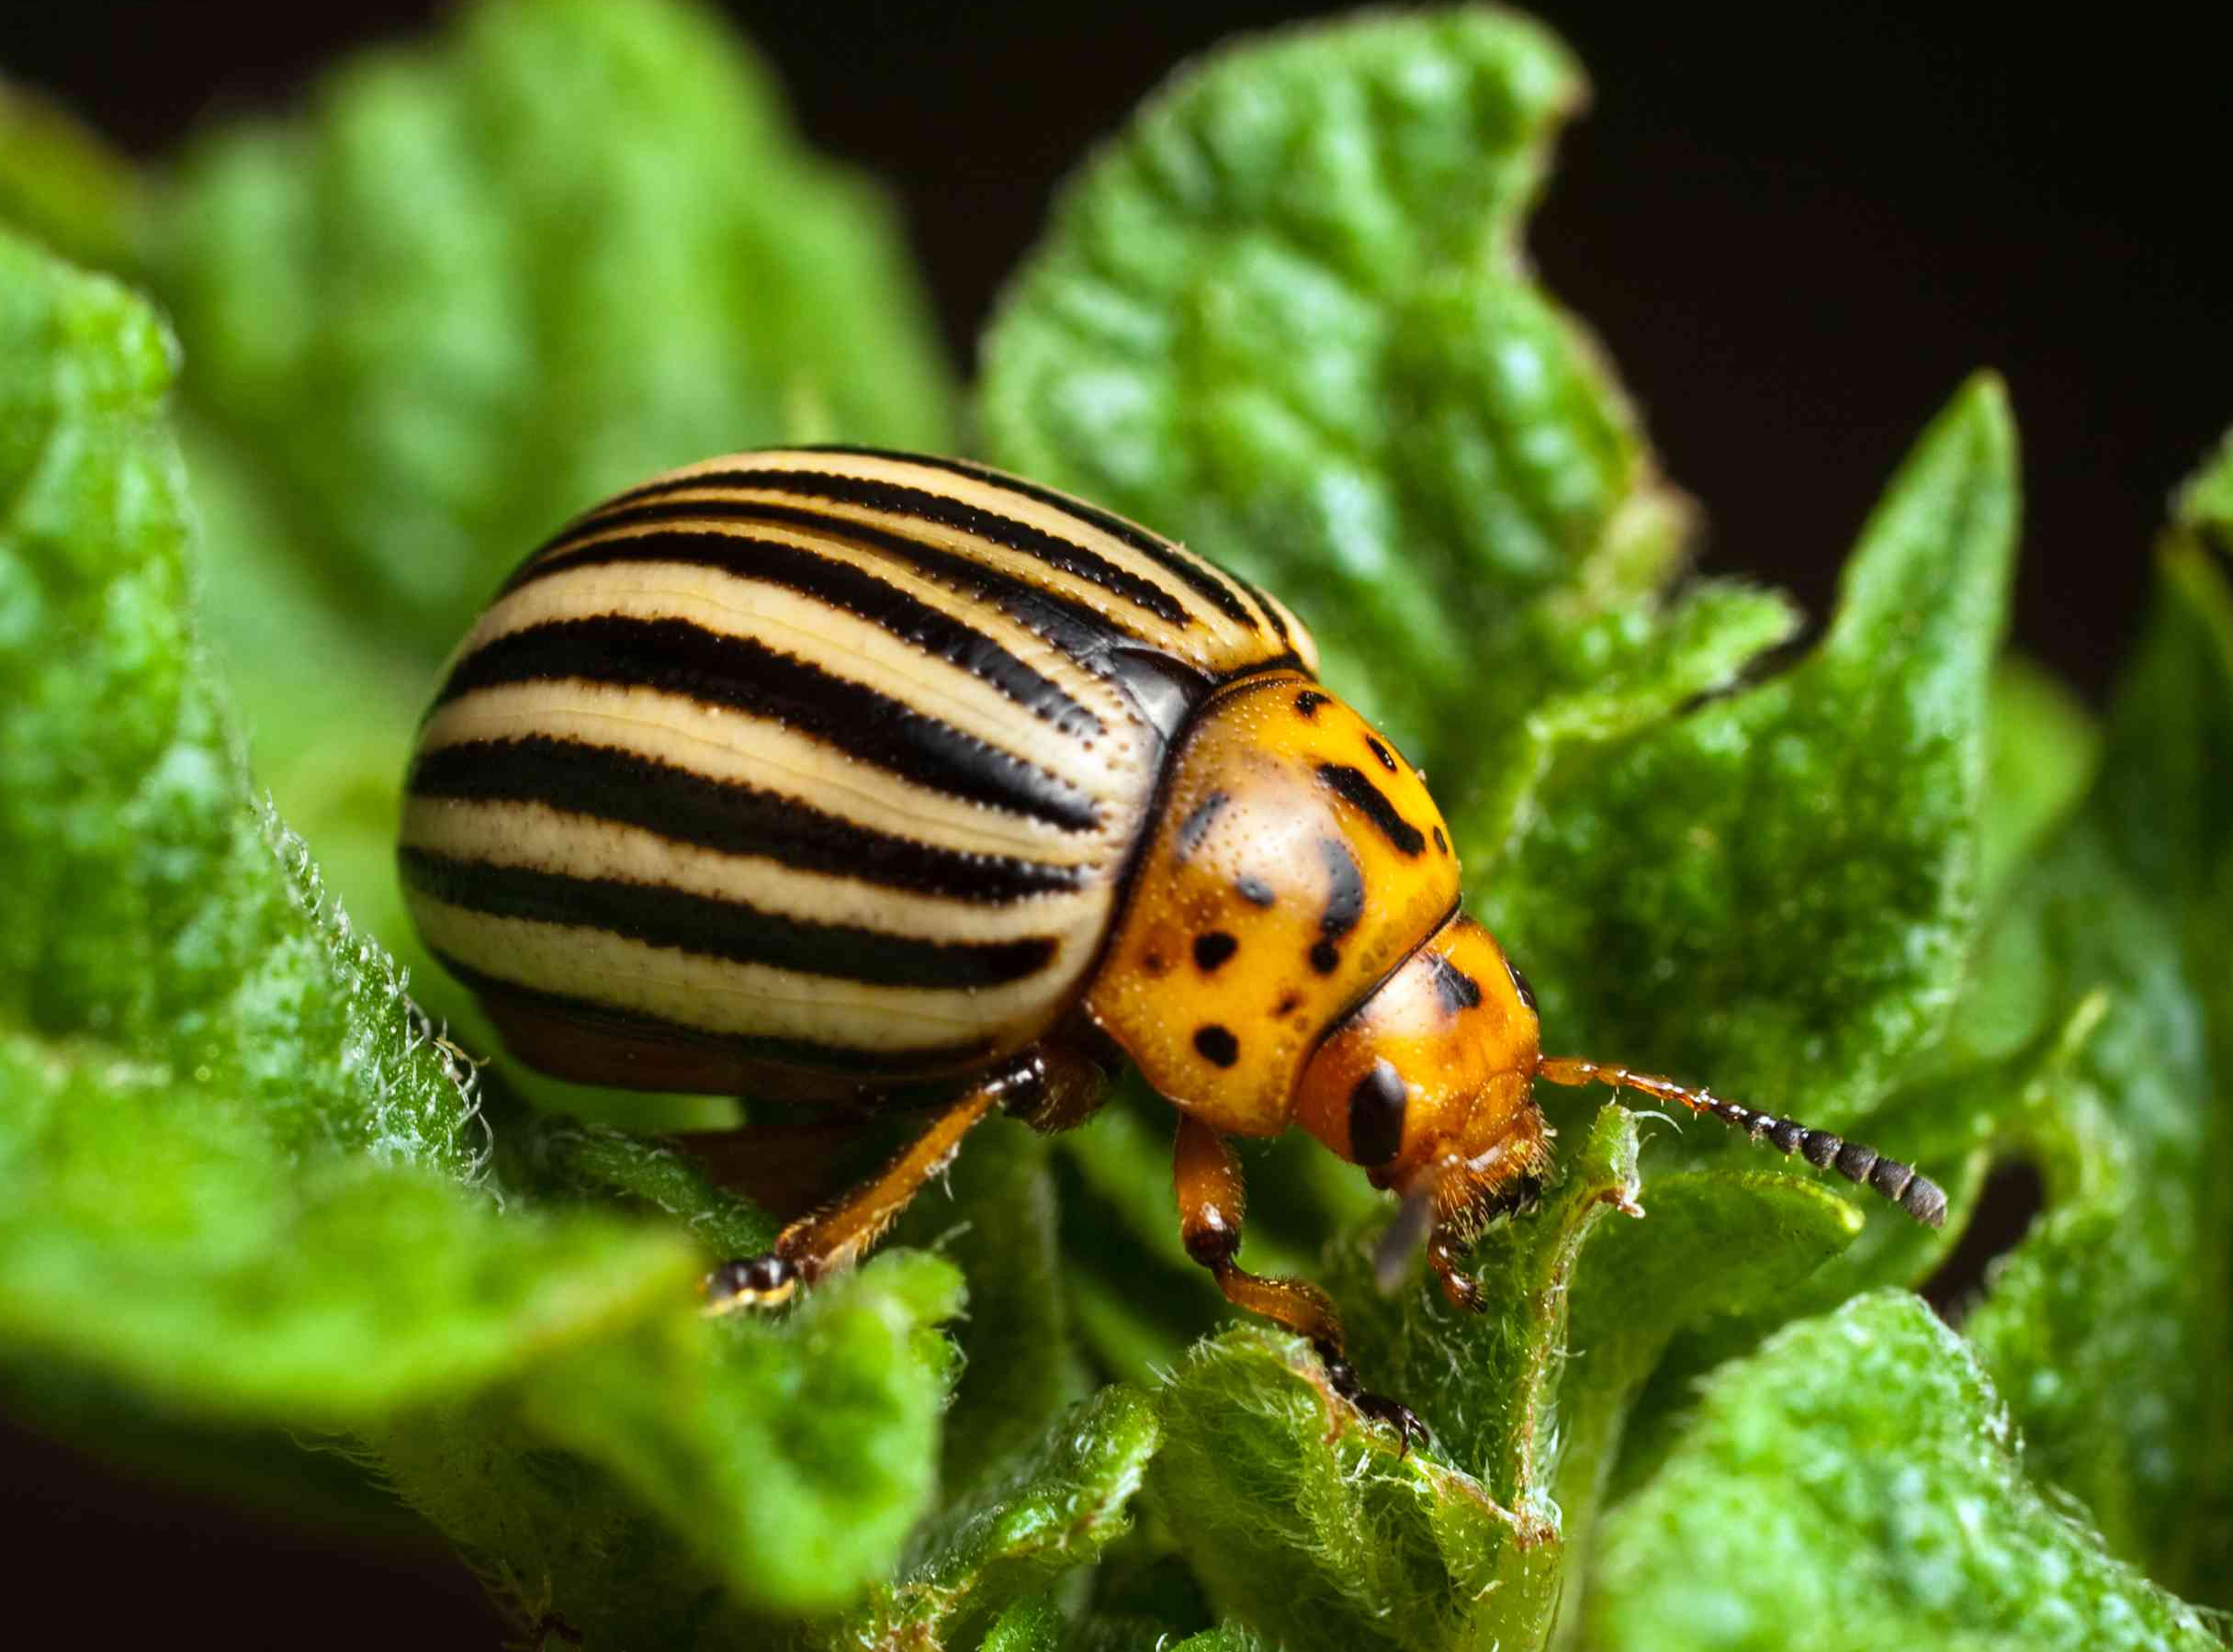
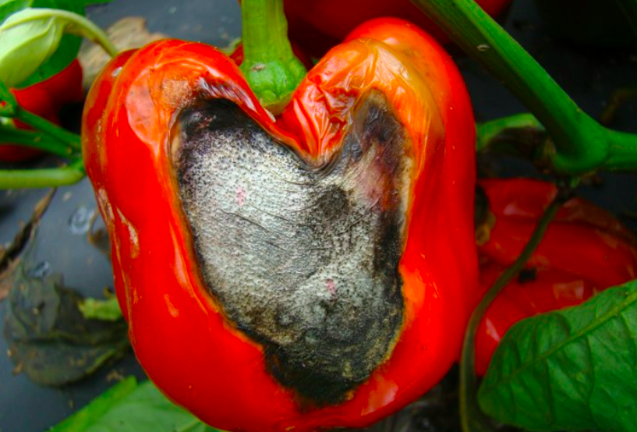
Problematic Rotations
Nightshade (Solanaceae) crops
  Susceptibility to similar pests / pathogens
  Similar nutrient requirements
tomatoes
peppers
potato
Colorado potato beetle (Source: thespruce.com)
Cucurbits
  Susceptibility to similar pests / pathogens
cucumber
Summer squash
Winter squash
Anthracnose
(Source: plantvillage.psu.edu)
Notes:
Examples of problematic rotations.
What do both of these rotations have in common? They both show a sequence of crops from the same family being grown in the same location. Both of these families, the nightshades and the cucurbits are heavy feeders.
The images show a disease on the nightshades and a pest for cucurbits ( the Colorado potato beetle).
The potato beetle image underscores the point that crop rotations following the principles in this module are also thought to decrease the risk of pest outbreak (not only soil borne disease).
Slide courtesy of Indiana Urban Soil Health Program.

Slide 15
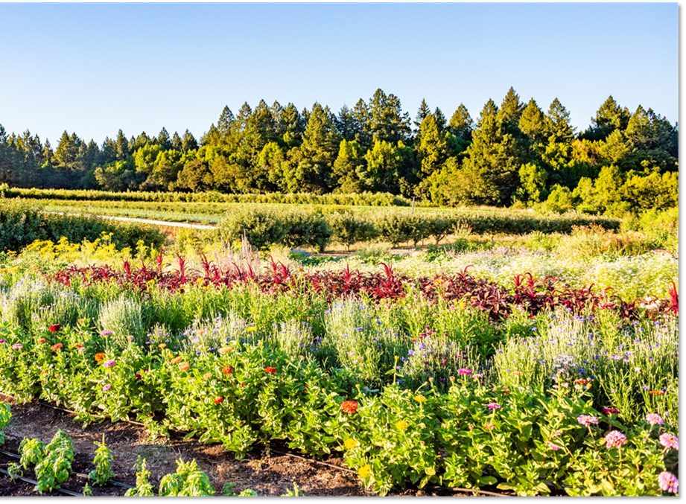
CPS 328 Considerations - Diversity
Minimize fallow (periods of bare ground)
Crop sequence should include mix of different crop types.
Longer crop sequences (four or more years) are more effective with no more than two consecutive years with the same crop.
Notes:
This slide contains a few considerations from the CPS 328 practice standard that apply to the concepts in this module.
Photo: courtesy of Sustainable Agriculture Program, Santa Rosa Junior College. Diverse, small-scale garden in the foreground.

Slide 16
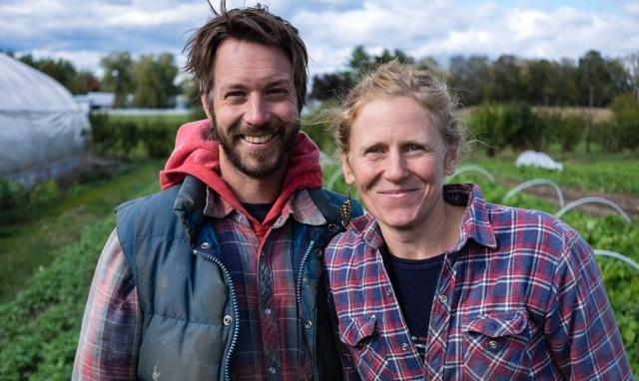
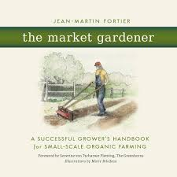
Rotation Principles – Market Gardener
Heavy feeders are followed by light feeders.
Compost is applied with the heavy feeders, not the light feeders.
Root vegetables are alternated with leaf vegetables.
Crops that are easy to weed are grown the year before onions which are difficult to keep weed free.
Notes:
The authors of the book “The Market Gardener” have had a huge influence on small-scale farming in North America during the past decade. This couple started a small-scale vegetable farm in Quebec, Canada twenty years ago. They developed a soil management system that was optimized for their operation and shared the framework for operating their farm in the book “The Market Gardener.” Jean Martin Fortier is now a well know educator and who focuses on developing training materials for beginning growers.
One aspect of this book that is particularly helpful is their explanation of the principles that they use to guide their crop rotation. Key principles from their rotation are outlined in the bullet points above.
Go through each bullet point.
Photo: from civileats.com – Jean Martin Fortier and Maude Helene Desroches. Authors of “The Market Gardener” and founders of “La Grellinette” farm, a 1.5 acre diversified vegetable farm in Quebec, Canada.

Slide 17
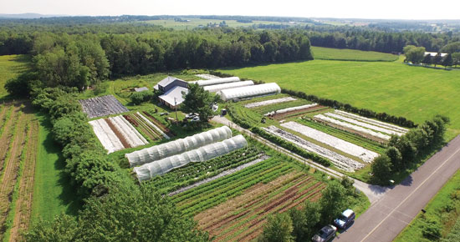
Rotation Principles – Market Gardener
Year | Crop
1 | Solanaceae + Compost
2 | Greens + Roots
3 | Garlic + Compost
4 | Greens + Roots
5 | Late Cucurbits and Brassicas + Compost
6 | Greens + Roots
7 | Amaryllidaceae + Compost
8 | Greens + Roots
9 | Early Cucurbits and Brassicas + Compost
10 | Greens + Roots
Notes:
This is their full ten-year rotation of vegetable crops. The farm is organized in ten distinct “blocks” of permanent beds. This rotation moves across their farm so that each of the heavy feeding crop families does not return to the same block for ten years.
The heavy feeder crop families are written in bold text. The table also denotes the compost application that occurs with each of the heavy feeder crops.
Photo: themarketgardener.com – aerial view of Les Jardins de la Grelinette

Slide 18
Research on crop rotations and soil health
Recent research has demonstrated that moving to a more diverse crop rotation can improve soil health by
  Increasing SOC and improving an overall soil health index (Yan et al. 2024).
  Increasing soil microbial biomass and root growth, as well as improving other soil indicators (Baldwin-Kordick et al. 2022)
Meta-analysis of 148 studies comparing rotations found that increased crop diversity
  Consistently improved soil physical properties.
  Diverse crop rotations (in place 5–10 yr) showed greater benefits
    with mean ann. precip. > 900 mm, and
    in medium- and fine-textured soils (Iheshiulo 2023).
Notes:
Now that we have gone through the principles of how rotations work - what does research literature say about increasing diversity in crop rotations??
These are very recent studies from very well regarded academic journals that demonstrate soil health benefits of increasing diversity in crop rotations. The caveat with these studies is that they are all based upon larger scale farms and farming systems. There is not much information in the research literature about the impact of crop rotations in small-scale systems.
Go through bullet points one by one.
The final bullet point is interesting because it highlights the importance of (1) time that the practice is in place, (2) climate and precipitation, and (3) soil type.
Yang, X., Xiong, J., Du, T. et al. Diversifying crop rotation increases food production, reduces net greenhouse gas emissions and improves soil health. Nat Commun 15, 198 (2024). https://doi.org/10.1038/s41467-023-44464-9
Baldwin-Kordick, R., De, M., Lopez, M. D., Liebman, M., Lauter, N., Marino, J., & McDaniel, M. D. (2022). Comprehensive impacts of diversified cropping on soil health and sustainability. Agroecology and Sustainable Food Systems, 46(3), 331–363. https://doi.org/10.1080/21683565.2021.2019167
Iheshiulo, E. M. A., Larney, F. J., Hernandez-Ramirez, G., Luce, M. S., Liu, K., & Chau, H. W. (2023). Do diversified crop rotations influence soil physical health? A meta-analysis. Soil and Tillage Research, 233, 105781.

Slide 19
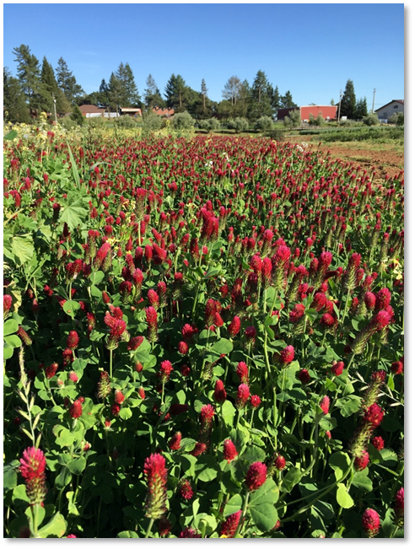
Compaction: (slight) Deep rooted crops in the rotation may reduce compaction
Soil organism habitat: (slight) Diversity of annuals and perennials in rotation improve quality of food, shelter and cover.
Aggregate instability: (moderate) Rotations with high residue crops build soil organic matter, diversity of root structure impacts aggregation.
Organic matter depletion: (mod to subst) High residue crops can lead to increased root development and increased soil organic carbon
Conservation Crop Rotation – Physical Effect on SH Resource Concerns
Notes:
What does the NRCS Conservation Practice Physical Effects tool say about the impact of conservation crop rotations on these soil health resource concerns?
Go through one by one and briefly discuss the implications of these processes on design of crop rotations.

Slide 20

Ideas on Crop Rotations
From Expert Farmers
Manage fields (blocks, beds, etc.) according to their own rotation.
Be flexible with rotations.
Balance business decisions with biological decisions.
Design crop sequences to support key crops through future years
Notes:
A final slide on thoughts on developing crop rotations. These ideas are taken from the USDA SARE manual “Crop rotation on organic farms: A planning manual”. These ideas were provided by the expert farmers who contributed to that book.
One point of discussion here is that of flexibility. Some producers believe strongly in remaining flexible in ones rotation. This may be for a variety of reasons: responding to a given year’s weather conditions, taking advantage of unique or new market opportunities, etc.
Other producers are very strict about sticking to their crop rotation and not deviating. The Market Gardeners is an examples. Their advice is that they do not deviate from their rotation.
Ultimately that is a decision that the grower needs to make themselves.
Photo: Josh Beniston, USDA NRCS. A cover crop of crimson clover (Trifolium incarnatum) flowering on an organic vegetable farm.

Slide 21
Rotation Card Game
Work in groups to develop a crop rotation that is consistent with the principles in this module and addresses the scenario that you are given.
Notes:
Now break the class into groups to work on the crop rotation card game. The game and instructions for organizing it are provided in the supplementary files for the training ??

Slide 22
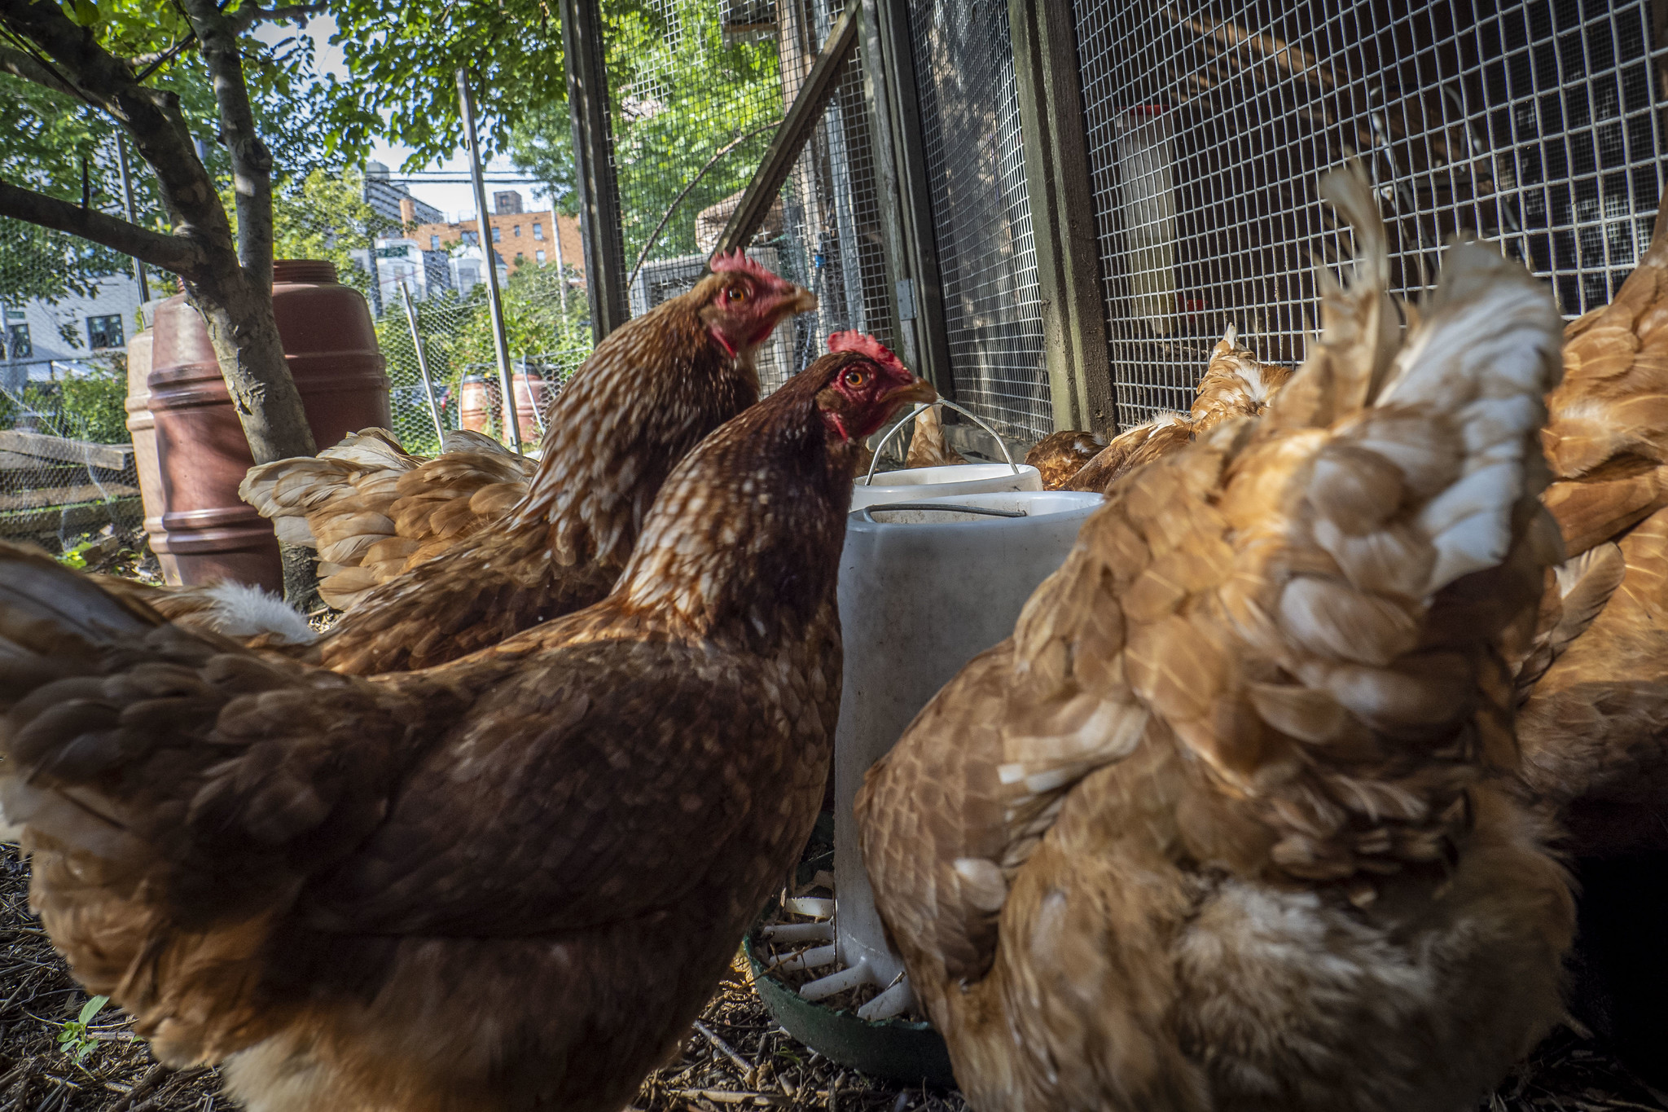
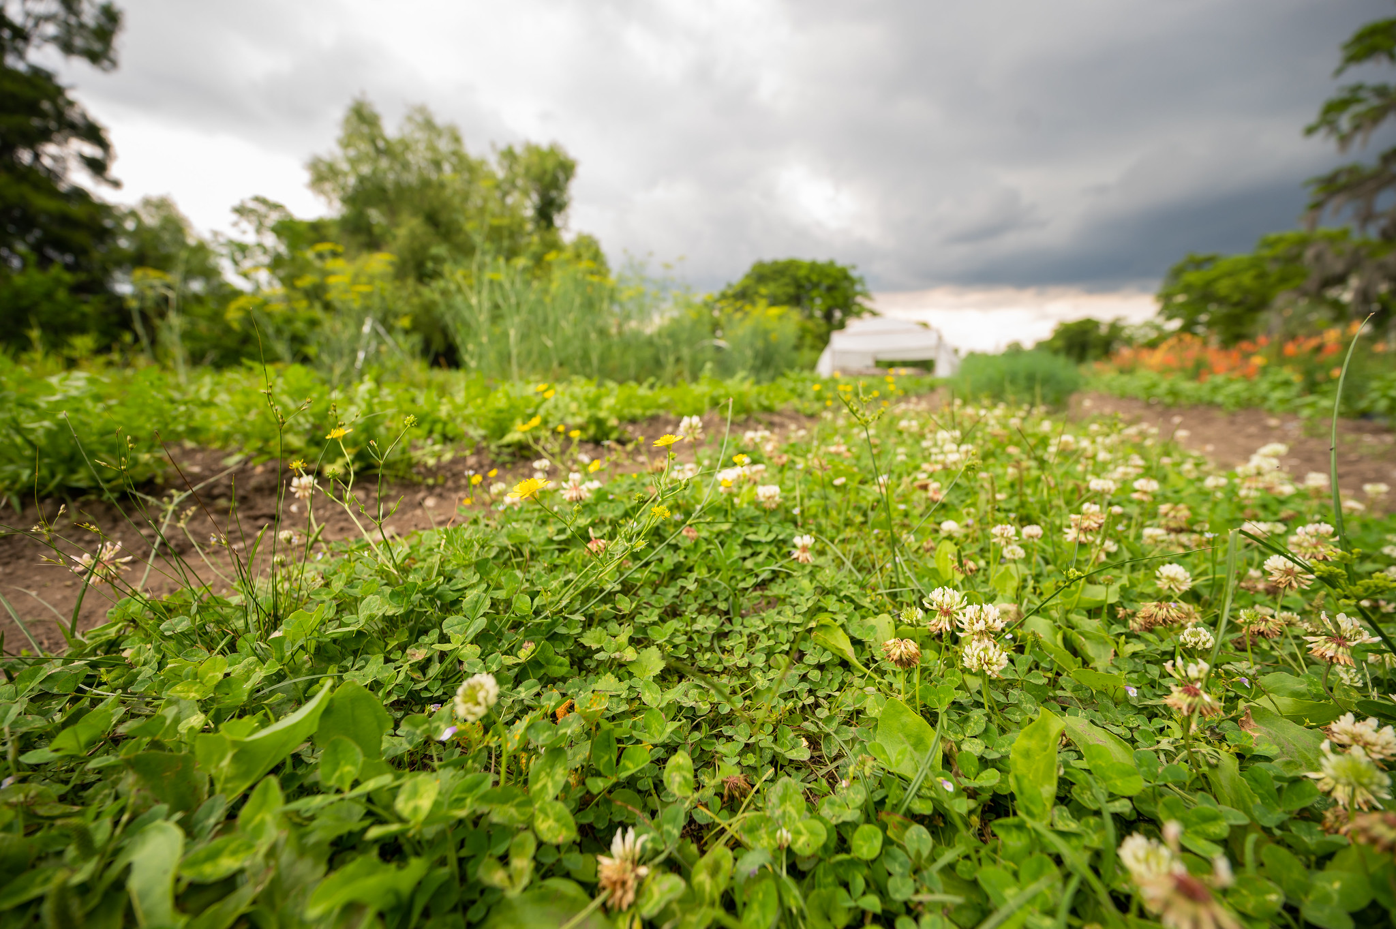
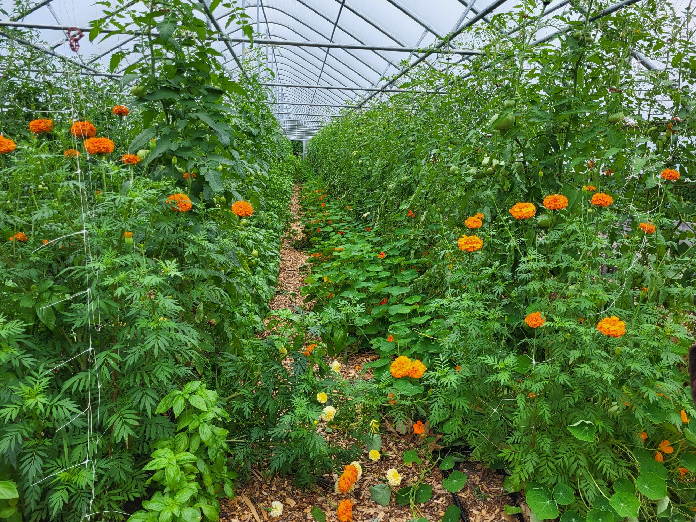
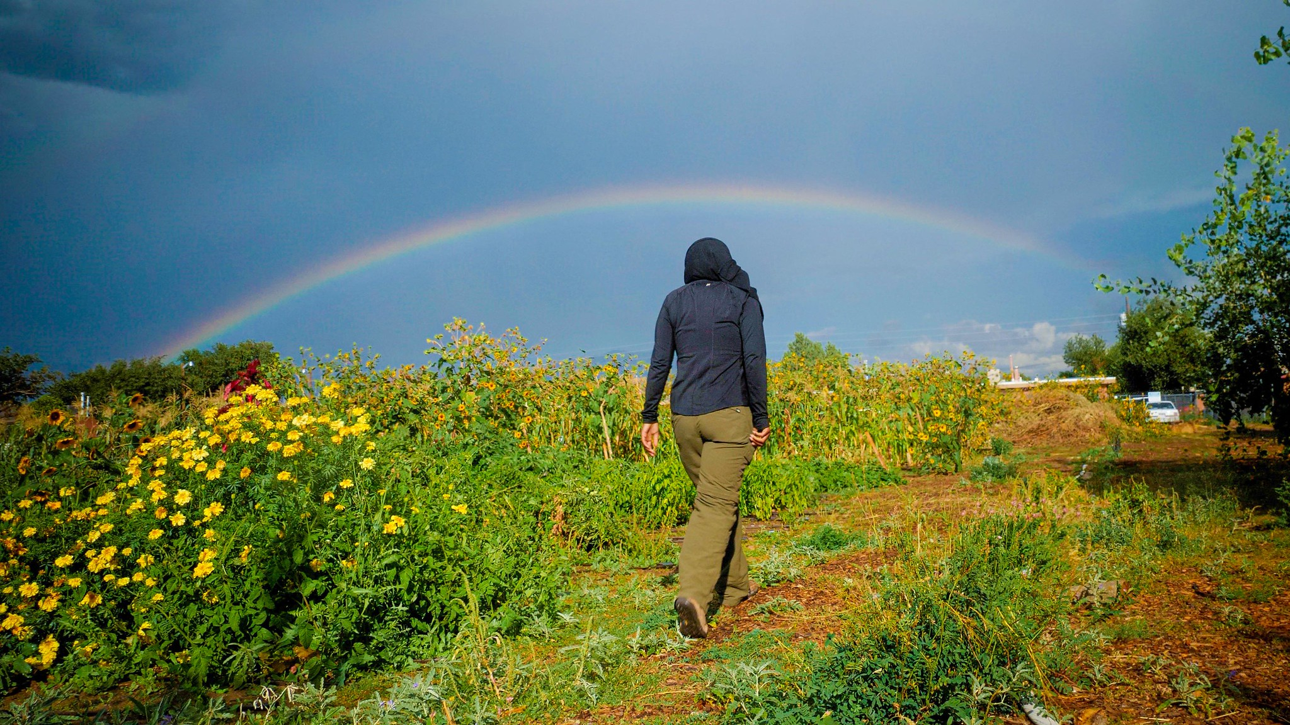
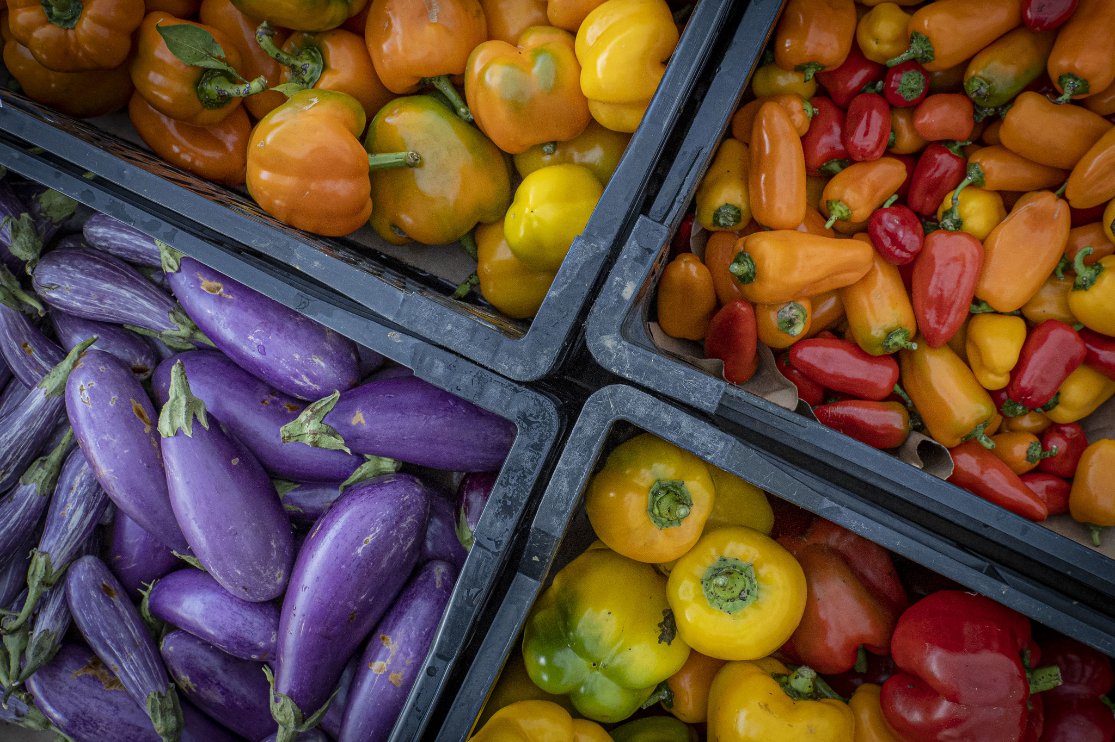
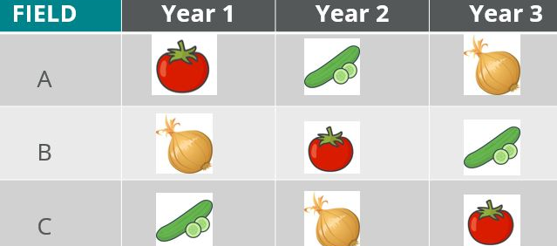
Other Ways to Maximize Diversity
Notes:
There are many ways to maximize diversity on small farms. This can include things like incorporating animals or animal manure to the system, perennial vegetation (like clover in paths), annual vegetation like marigolds to help suppress pests, pollinator plants, growing a variety of vegetables, and crop rotation.

Slide 23
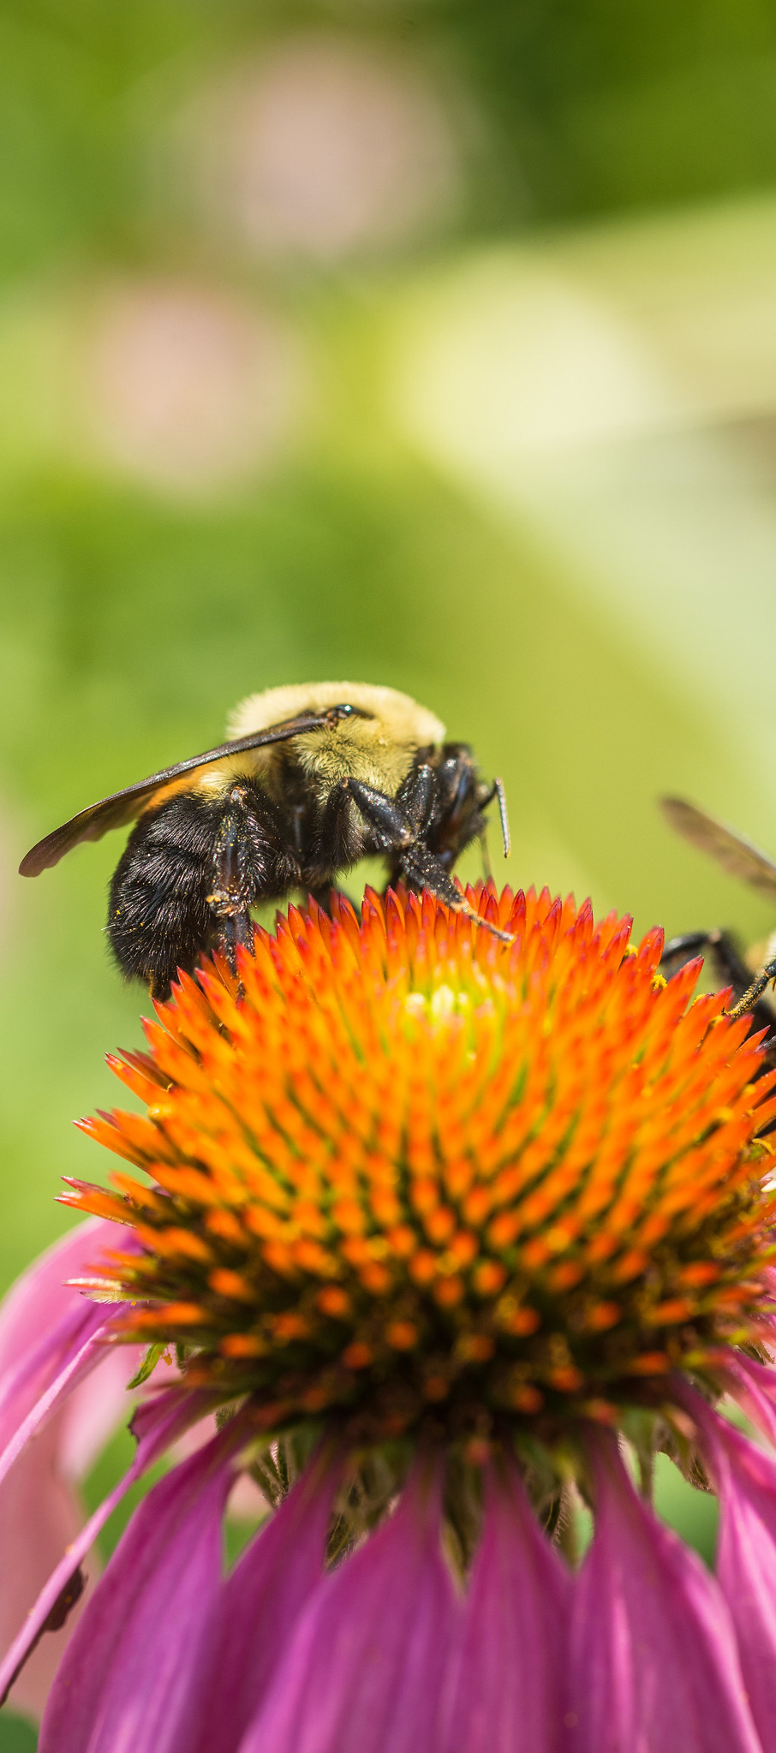
Conservation Practices for Maximizing Diversity
Practices:
  Alley Cropping (CPS 311)
  Cover Crop (CPS 340)
  Wildlife Habitat Planting (CPS 420)/ Conservation Cover (CPS 327)
  Hedgerow Planting (CPS 422)
  Tree and Shrub Planting (612)
  Culturally Significant Plantings for Soil Health (Interim CPS 825)
Notes:
Common practices for mazimizing diversit include:
Alley cropping: Alley cropping is an agroforestry practice where agricultural or horticultural crops are grown in the alleyways between widely spaced rows of woody plants. By combining annual and perennial crops that yield varied products and profits at different times, a landowner can more effectively use available space, time, and resources.
Cover Crop
Wildlife Habitat Planting:
Hedgerow Planting:
Tree and Shrub Planting:
Culturally Significant Plantings for Soil Health

Slide 24
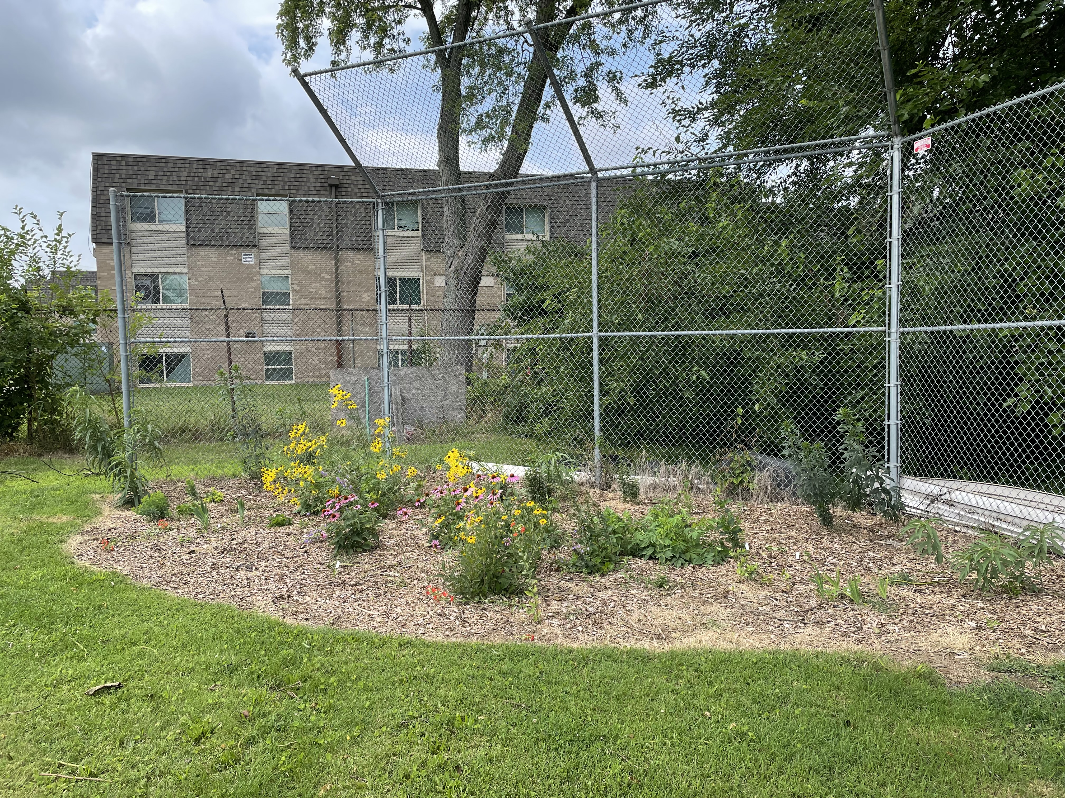
Wildlife Habitat Planting(CPS 420)
Use CPS 420 only when wildlife habitat is a primary purpose and RC
Urban areas provide patches of habitat or habitat function
  Serve as stop over points providing food and shelter for migratory species (such as birds and insects)
  Provide food for specialized butterfly and moth species, some declining
Notes:
▪ Use CPS 420; Wildlife Habitat Planting only when wildlife habitat is a primary purpose, with inadequate wildlife habitat being the resource concern (otherwise use other planting practice)
▪ Creating habitat (providing food, cover, water or enabling movement) helps address the biggest threat to wildlife; habitat loss and degradation
▪ While large, intact areas of natural habitat are of greatest value, urban areas do provide patches of habitat or habitat function (which are becoming more important as more and more natural habitat is lost)
- Serve as stop over points providing food and shelter for migratory species (such as birds and insects)
- Provide food for specialized butterfly and moth species, some declining (whose caterpillars feed on only one species of plant that oftentimes is a perennial species)
▪ Providing habitat (that attracts and supports wildlife) has collateral benefits as wildlife can play a role in:
- Pollination
- Pest control
- Education and public engagement / stewardship (online migratory wildlife tracking tools, wildlife identification tools, citizen science opportunities help promote interest and engagement)
➢ Merlin App by Cornell Lab (it is GREAT!) allows you to identify birds by sight or sound - https://merlin.allaboutbirds.org/
➢ Site to track (and report) monarch sightings - https://journeynorth.org/monarchs
➢ Hummingbird tracking website (hummingbirds are good fit for urban plantings) - https://www.hummingbirdcentral.com/
▪ Be deliberate about the wildlife species that will benefit and use a WHEG or other tool to identify the species-specific habitat needs of that species so that habitat benefits (and collateral benefit) are realized
Attached is a sample information handout from Illinois that identifies, relative to a specific crop (in this case pumpkins and squash), essential pollinators and natural enemies of pest species associated with the crop and the plant species that support the pollinators and beneficial insects
Photo: Josh Beniston, USDA NRCS. A small wildlife habitat planting on the edge of an urban community garden. Hamilton, OH.
-

Slide 25
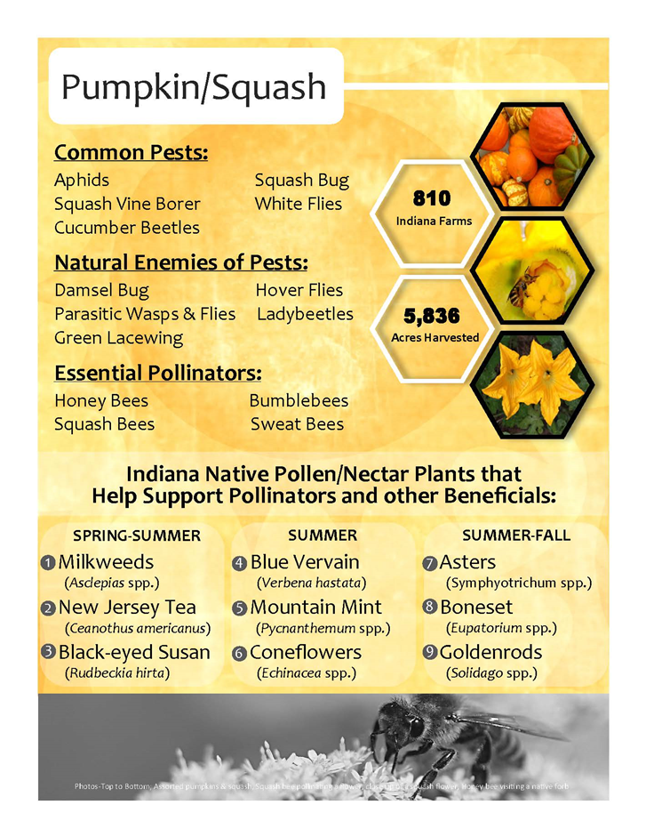
Wildlife Habitat Planting(CPS 420)
Be deliberate about the wildlife species that will benefit and use a WHEG/other tool or speak to a pollinator specialist to identify the species-specific habitat needs.
Xerces is a great resource!
Notes:
so that habitat benefits (and collateral benefit) are realized
Pollinator plantings on farms where honey are also a crop – 420 can support both.

Slide 26
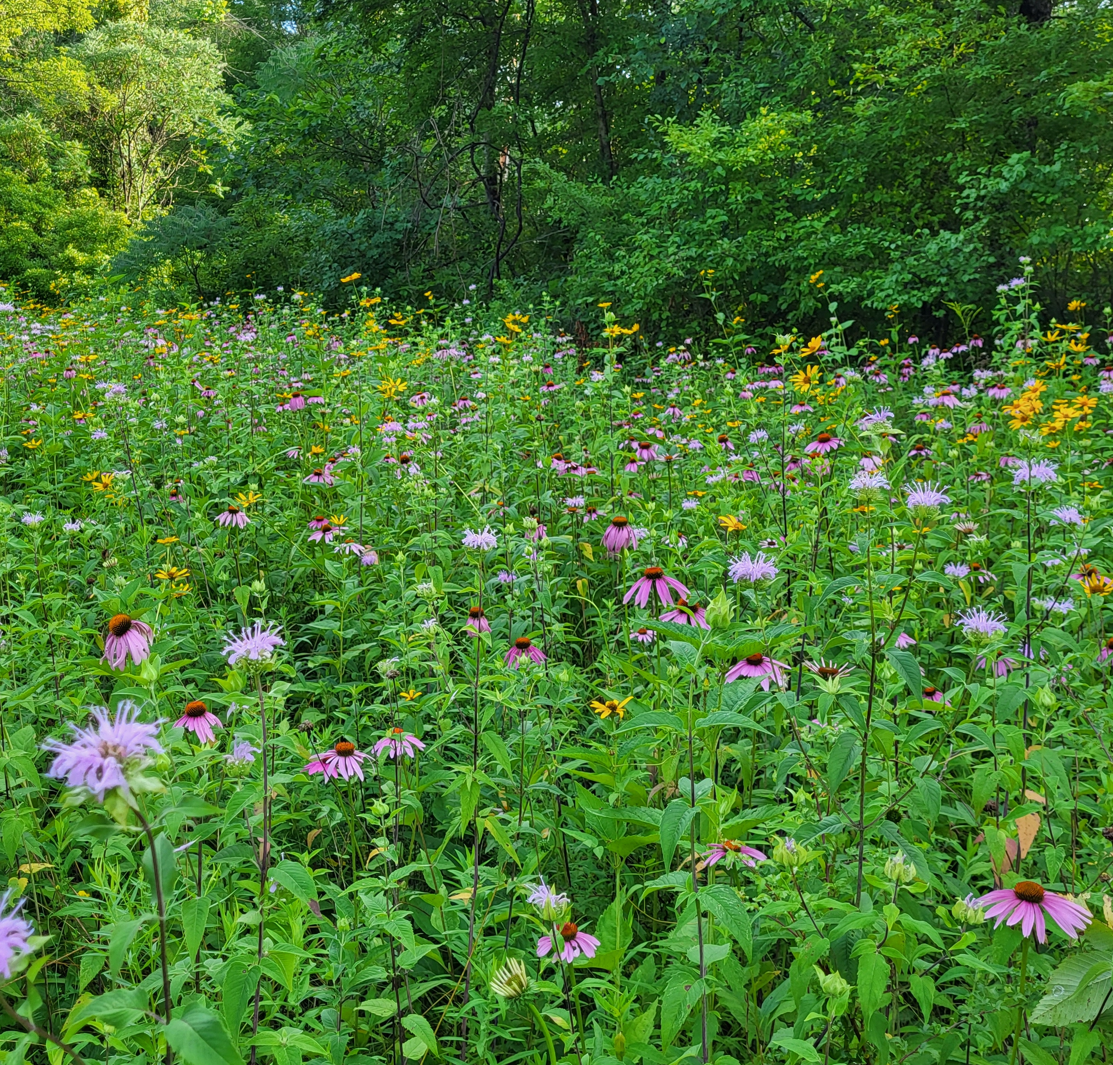
Common Wildlife Habitat Planting Scenarios
Pollinator Strips
Insectary Strips
Native Wildflower Meadows
Beetle Banks
Notes:
Under 420 Wildlife Conservation Plantings there are several different scenarios which can help facilitate biodiversity. They encourage beneficial insects that may help with pest control and reduce the need for chemical sprays. These scenarios include:
Insectary strips (consists of annual vegetation).
Perennial Vegetation in the form of pollinator strips, insectary strips, and beetle banks that are interspersed and/or directly adjacent to crop land can also be a great first step in creating no till areas. No-till areas promote soil biology which can help with nearby nutrient cycling and water infiltration.

Slide 27
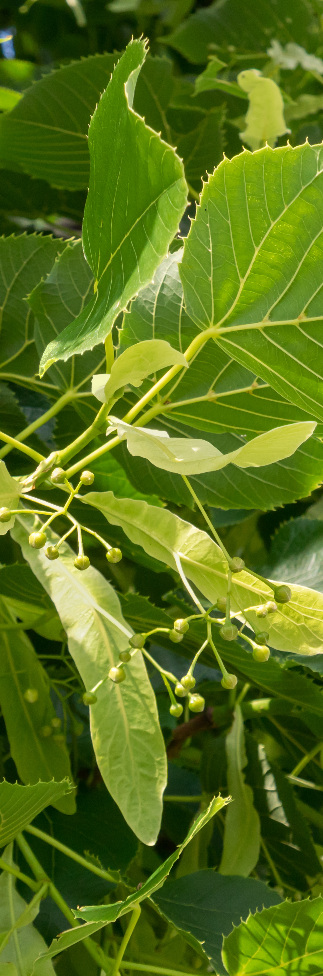
Trees (CPS 612) Can Provide Shade AND Beneficial Insect/Soil Biology Food/Habitat
Approximately 30% of native bees nest in hollow plant stems, old bore holes, tree snags, and brush piles.
Trees, such as American basswood (Tillia americana), are often excellent sources of early season pollen. (Bonus: the flowers and modified petals can be dried to make tea.)
Trees can promote mycorrhizal fungi in the soil.
Notes:
In addition to providing shade, which can help reduce temperatures in urban environments, trees can be habitat to beneficial insects such as pollinators.
Trees can promote mycorrhizal fungi in adjacent crop land areas, as the fungal network established by tree roots can extend into nearby soil, effectively providing a source of mycorrhizal fungi for crops growing in the vicinity, thus enhancing their nutrient uptake and growth; this phenomenon is often referred to as the "wood wide web.“ Leaves may also be used for mulch (if not grown in lead contaminated soil).

Slide 28
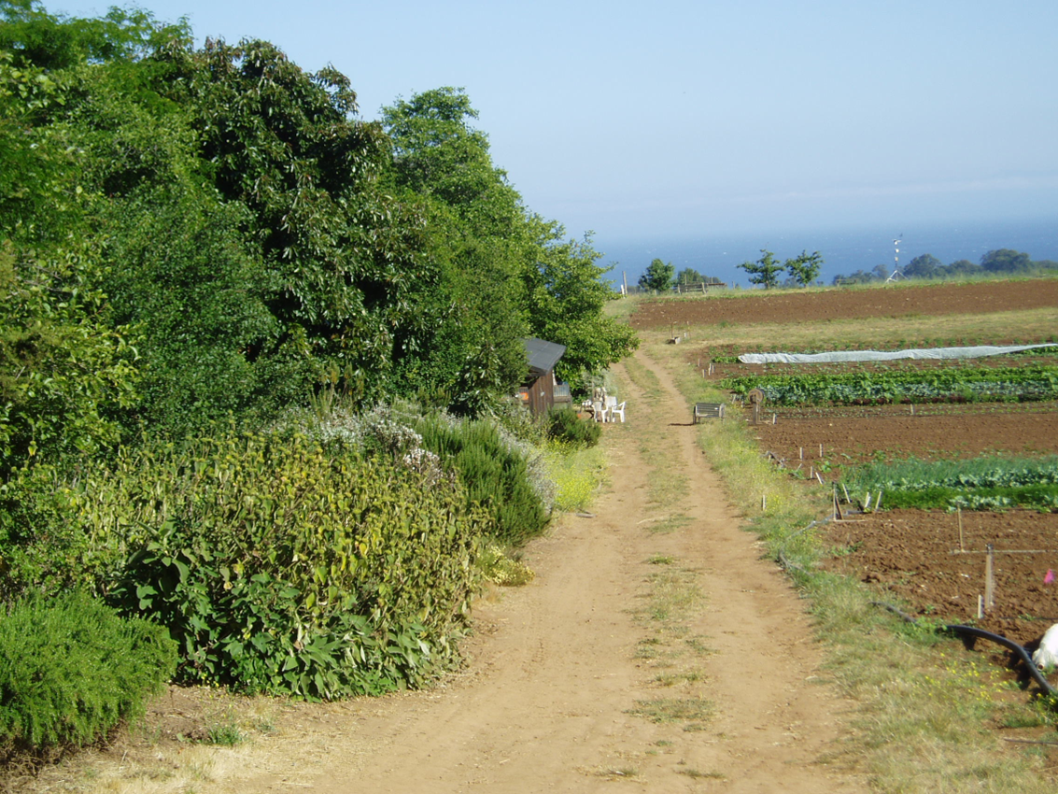
Hedgerow Planting (CPS 422)
Establishment of dense vegetation in a linear design to achieve a natural resource conservation purpose.
Several purposes including:
  Soil Carbon
  Habitat
  Pollinators
  Screens and Barriers
Notes:
Hedgerows are an excellent practice for incorporating biodiversity and improving soil health in spaces that are not used for crop production on the edges of small-scale and urban farms. Hedgerows are composed primarily of woody tree and shrub species. Hedgerows are very multi-functional and can provide many benefits including those listed on the slide. A recent study conducted on farms in the Central Valley of California documented increases in soil carbon to at least one meter depth on areas planted to hedgerows. https://www.mdpi.com/2071-1050/14/19/12901
Photo: Josh Beniston, USDA NRCS. A mature hedgerow on the edge of an organic vegetable production field. Santa Cruz, CA.

Slide 29
Tips for Successful Plantings
Plantings are easy to plan but much harder to implement (some of the highest failure rates of any practice).
Plan with the assistance of a biologist or pollinator specialist.
Make sure the participant has the resources (i.e. water, deer fencing) to carry out a successful planting and understands what is involved for O&M.
Weed control prior to planting is CRUCIAL!!
Wildflower establishment – 1st year they sleep, 2nd year they creep, 3rd year they leap.
Notes:
Pollinator and tree plants may be popular among participants, however a lot of work goes into preparing for and ensuring a successful planting. Make sure the participant is aware of what is involved with establishment, particularly weed and pest control.

Slide 30

Questions and Review
Maximizing diversity is one of the four principles of soil health.
Ecosystems that are more diverse are more resilient.
Maximizing diversity can be accomplished in a variety of ways. Practices include 328 Conservation Crop Rotation and 420 Wildlife Habitat Plantings

Slide 31

This information is provided as a public service and constitutes no endorsement by the United States Department of Agriculture or the Natural Resources Conservation Service of any service, supply, or equipment listed.
While an effort has been made to provide a complete and accurate listing of services, supplies, and equipment, omissions or other errors may occur and, therefore, other available sources of information should be consulted
The USDA is an equal opportunity provider and employer.
Meeh, NRCS

Slide 33
Crop Rotation Example
How can we improve the following rotation ?
Notes:
This question kicks off a quick discussion exercise. Ask the group this question and let them know that we will see the crop rotation on the following slide.
The goal will be to look for ways to add additional diversity to the crop rotation incrementally.

Slide 34
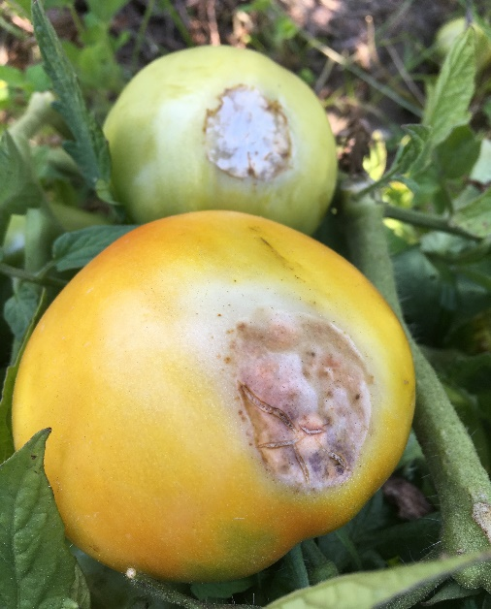
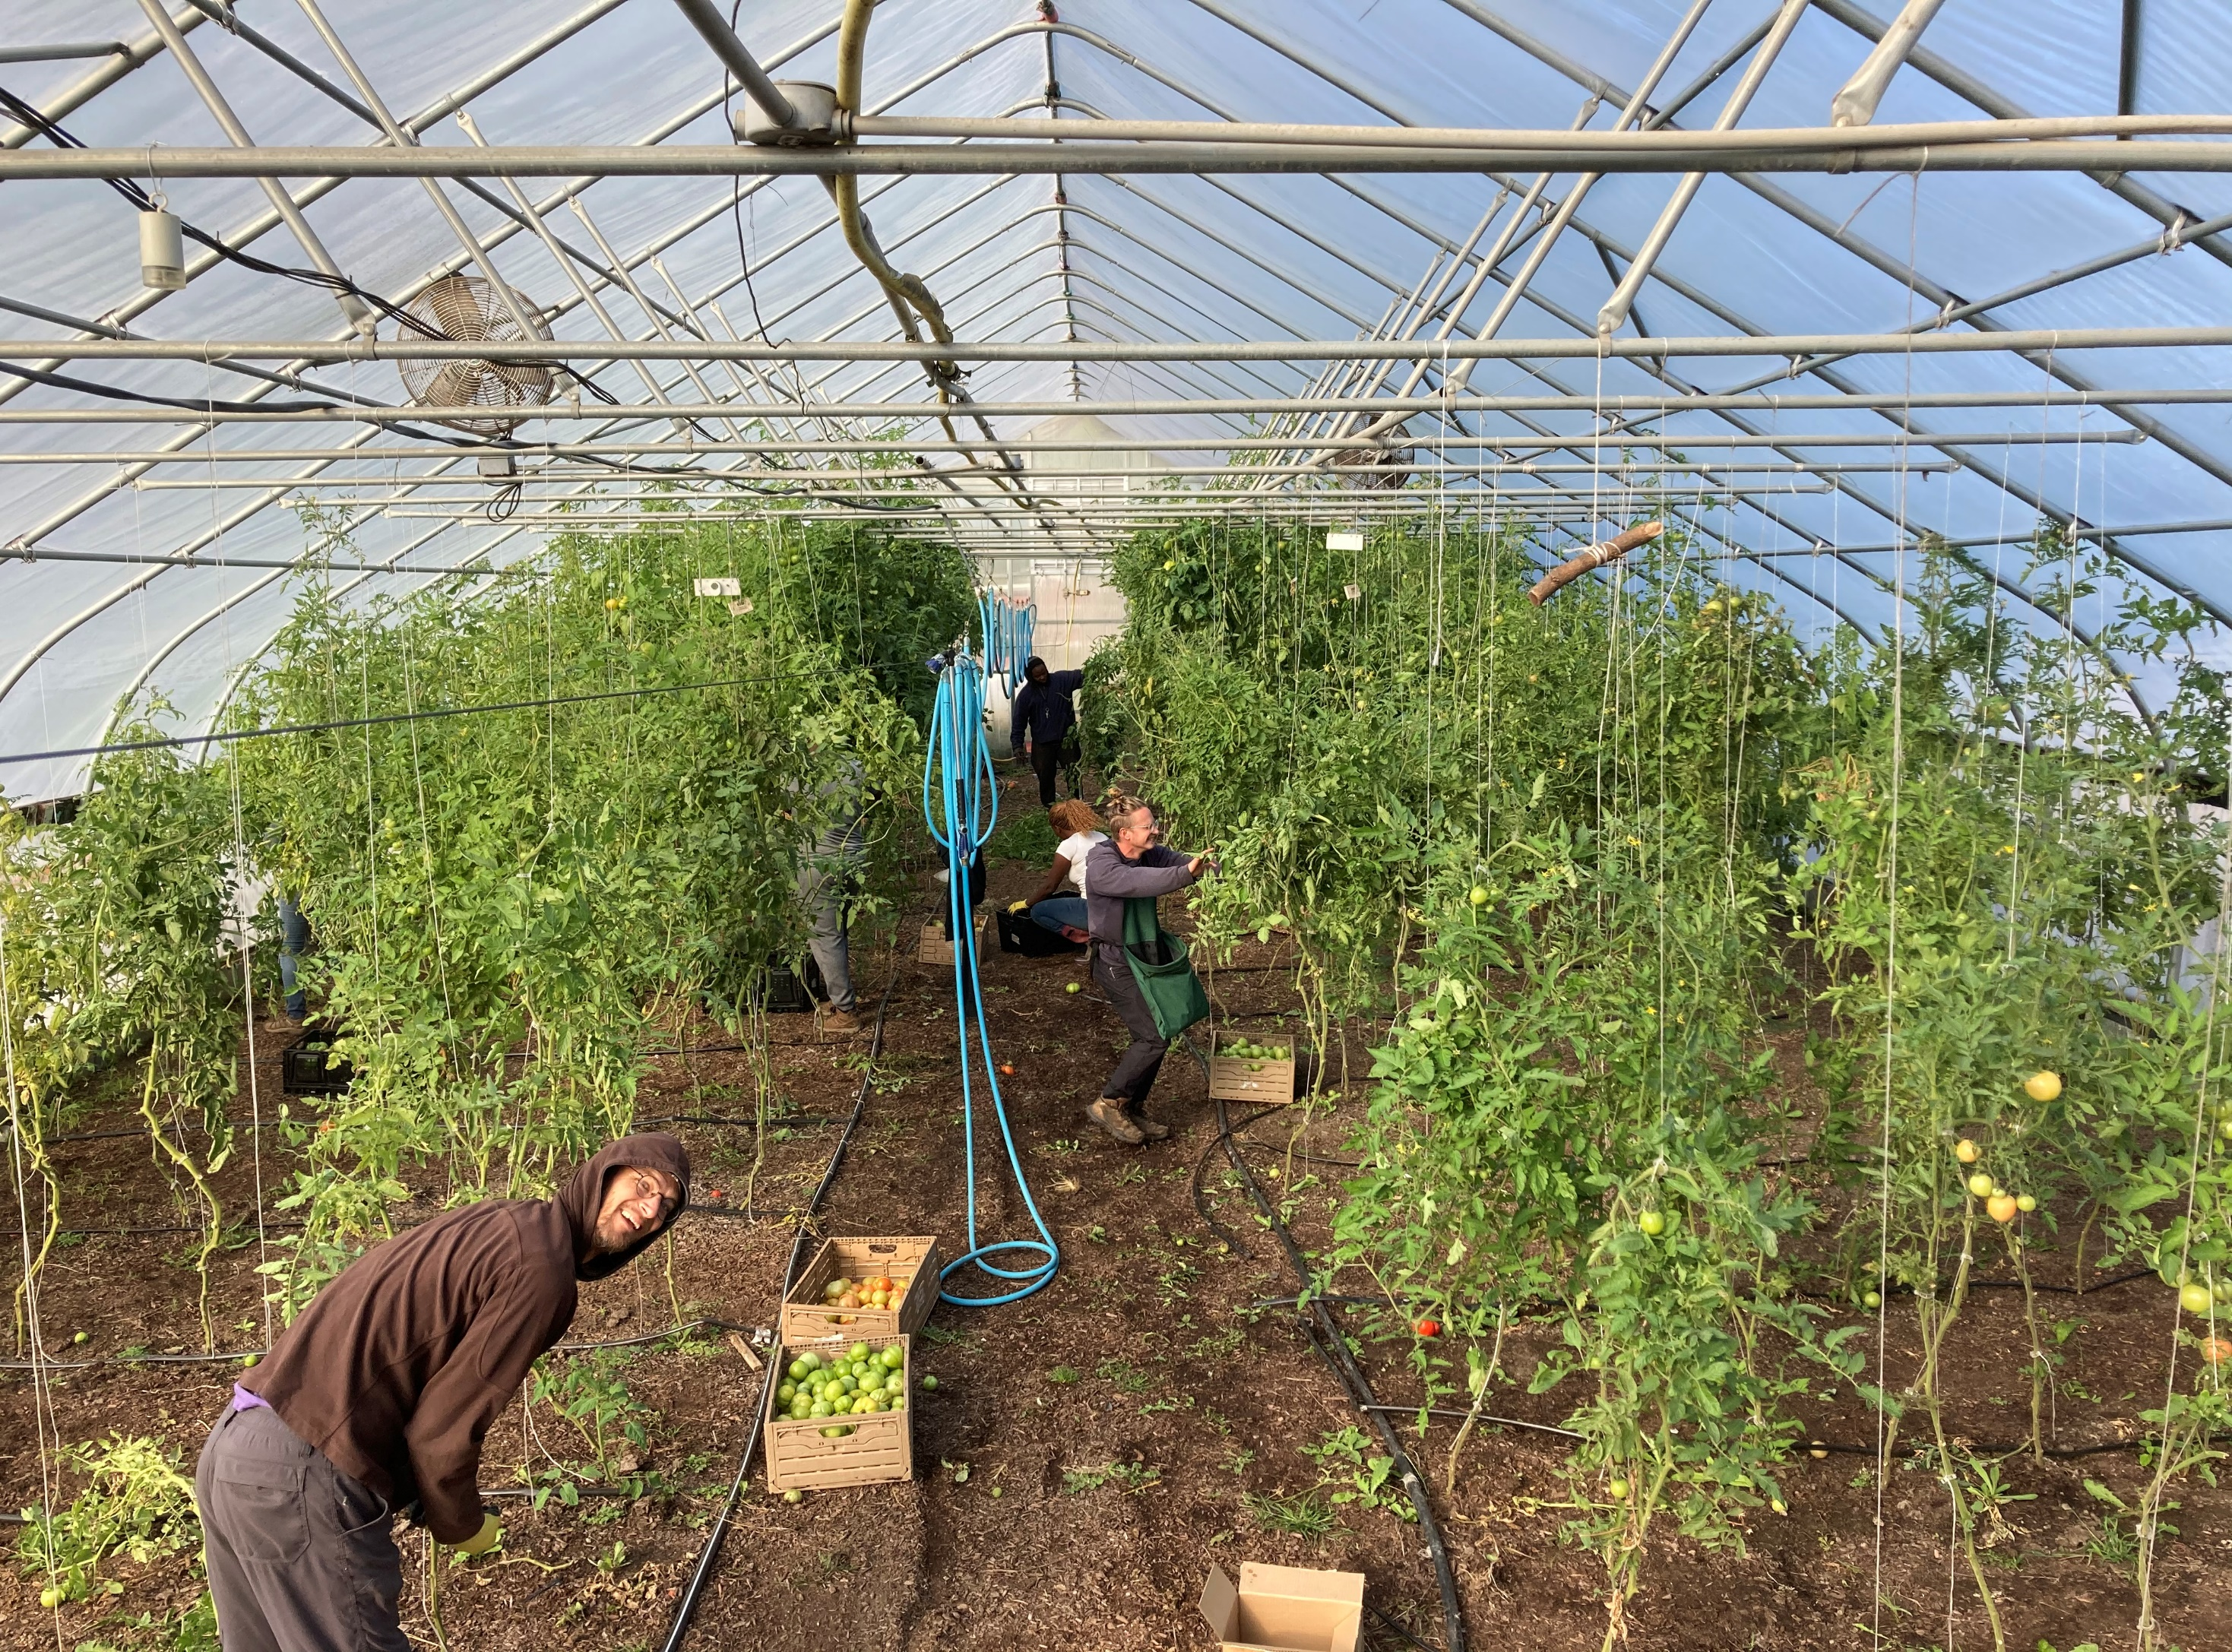
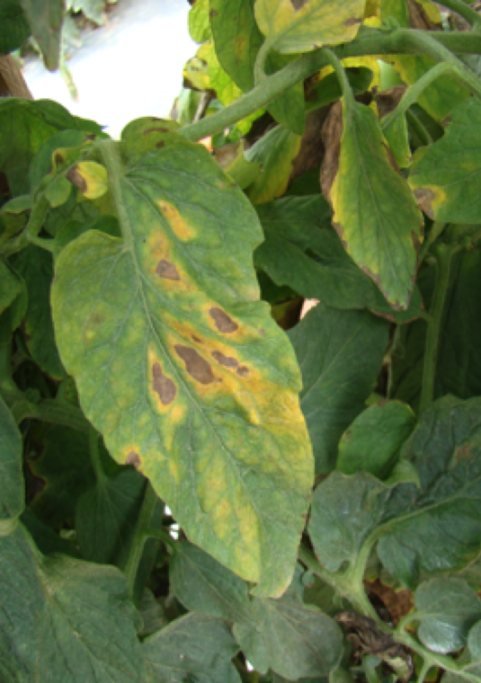

Early blight.
Photo: University of Florida Extension
2023 |  |  |  | 2024 |  |  |  | 2025
1 | 2 | 3 | 4 | 1 | 2 | 3 | 4 | 1 | 2 | 3 | 4
Tomato
Tomato
Tomato
Notes:
In this rotation, the producer on a small-scale farm is using their high tunnel to grow slider tomatoes during every late spring and summer season. The tomatoes typically yield well and they generate significant revenue for the producer on their diverse vegetable farm. They have used this rotation for the past handful of years.
This year the producer is experiencing multiple disease and pest issues on the tomato crop, including an early blight, which may be from issues with soil health. The producer has contacted us to ask if we can help them brainstorm adding diversity to their rotation without causing them a major reduction in revenue from their tomatoes.
What are some ways that this rotation could be diversified with a primary focus of improving soil health ?
This slide is used courtesy of Indiana NRCS and the Indiana Urban Soil Health Program

Slide 35

2023 |  |  |  | 2024 |  |  |  | 2025
1 | 2 | 3 | 4 | 1 | 2 | 3 | 4 | 1 | 2 | 3 | 4
Tomato
Oats and Peas
Tomato
Oats and Peas
Tomato
Oats and Peas
Notes:
One next step would be to consider a cover crop during the off season in the high tunnel. Probably could also look at “low feeding” vegetables in cool season, but the cover crop will do more for soil health.
This is a good example of maximizing living roots in a rotation.
This slide is used courtesy of Indiana NRCS and the Indiana Urban Soil Health Program

Slide 36
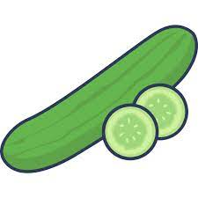

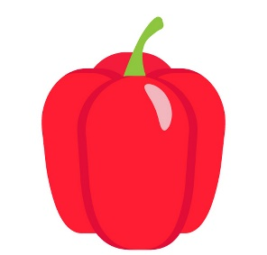
2023 |  |  |  | 2024 |  |  |  | 2025
1 | 2 | 3 | 4 | 1 | 2 | 3 | 4 | 1 | 2 | 3 | 4
Oats
Peas
Oats
Hairy vetch
Oats
Peas
Tomato
Cucumber
Pepper
Notes:
This rotation adds a lot more diversity to the high tunnel by looking at adding a cash crop from a different family during alternating warm seasons.
This rotation also incorporates a different legume in the winter cover crop mix in alternating years.
The potential issue with this rotation is that changing cash crops can be challenging for producers and may be a deal breaker. It is, however, possible to make a business pivot to more diverse crops, particularly if a major pest problem or crop failure is a possibility for the less diverse rotation. Ideally in this scenario, the producer would have more than one high tunnel and could rotate crop families across the tunnels to keep some production of the primary crop going.
This slide is used courtesy of Indiana NRCS and the Indiana Urban Soil Health Program

Slide 37
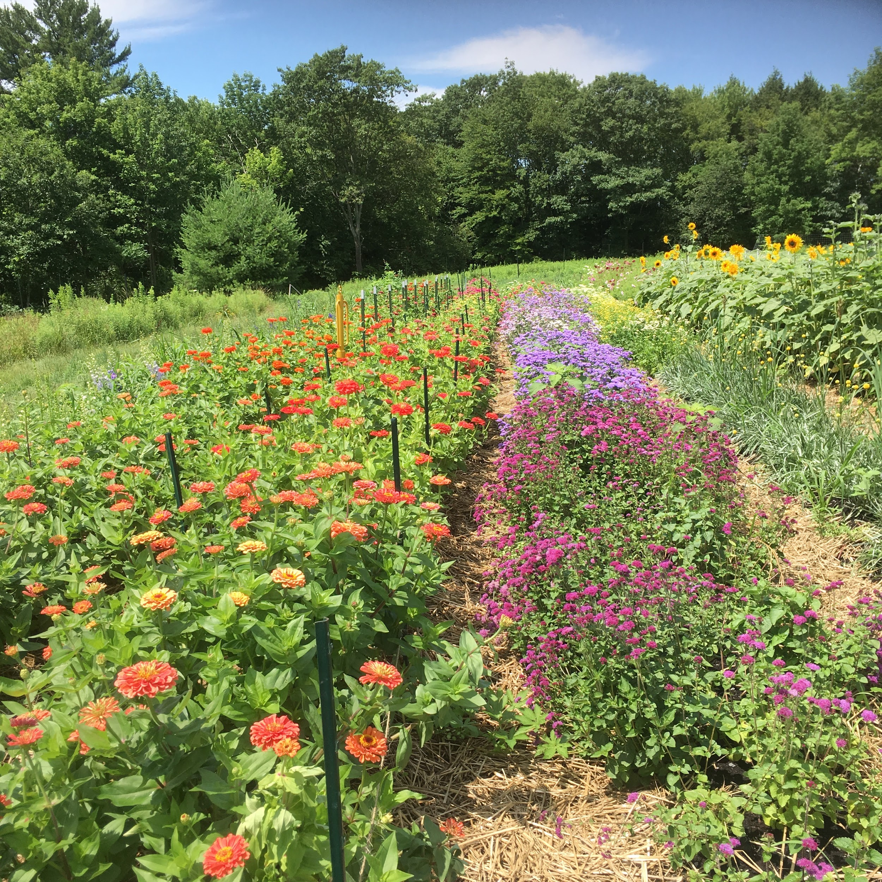
Importance of Maximizing Diversity
Resource Concerns: Soil Organism Habitat Degradation, Aggregate Stability
Diverse systems are stronger in nature. Example: If more than 20% of a farm is diverse habitat, pest control by beneficial insects is observed throughout the fields.
Source: Bianchi et al (2006). Sustainable pest regulation in agricultural landscapes: A review on landscape composition, biodiversity and natural pest control. Proceedings. Biological sciences / The Royal Society. 273. 1715-27.
Source: Tscharntke et al (2002). Contribution of small habitats to conservation of insect communities of grassland-cropland landscapes. Ecological Applications. 12. 354-363.
Notes:
Diversity can mean both above and below ground.

Slide 38
Conservation Crop Rotation
What are some key purposes for CPS 328 Conservation Crop Rotation ?

Slide 39
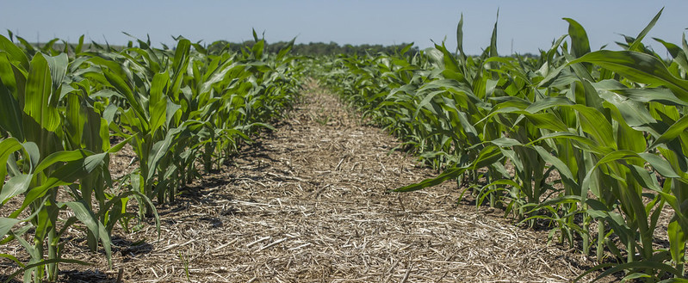
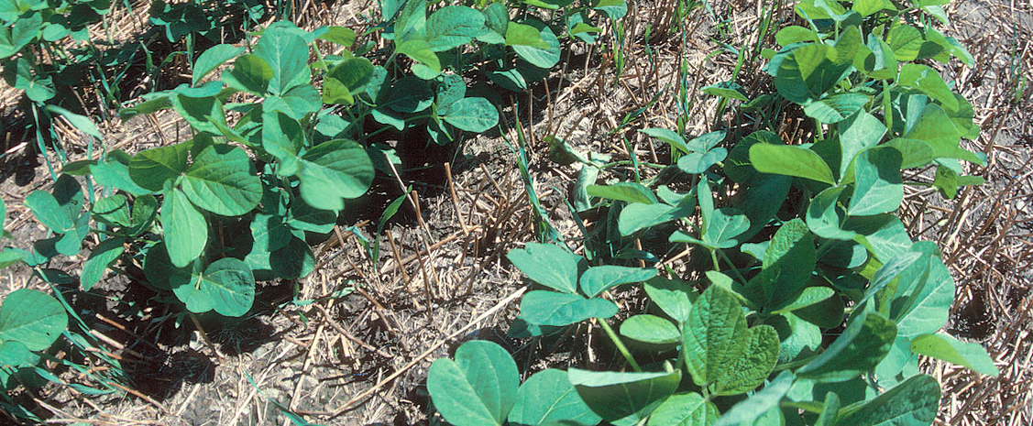
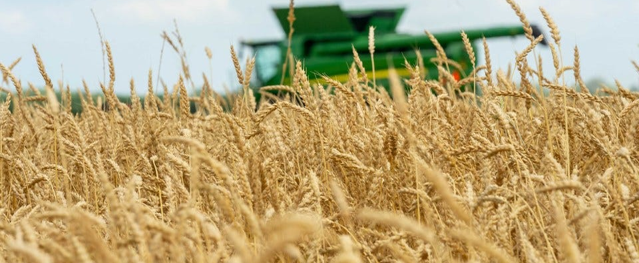
Adding diversity (1 more crop)
Adding high biomass cover crops
Conservation Crop Rotation
USDA NRCS Code 328
DEFINITION
A planned sequence of crops grown on the same ground over a period of time (i.e. the rotation).
PURPOSE
Reduce sheet, rill and wind erosion
Maintain or increase soil health and organic matter content
Reduce water quality degradation due to excess nutrients
Improve soil moisture efficiency
Reduce the concentration of salts and other chemicals from saline seeps
Reduce plant pest pressures
Provide feed and forage for domestic livestock
Provide food and cover habitat for wildlife, including pollinator forage, and nesting
Notes:
Move to after CART and right before Resources?

Slide 40
Conservation Crop Rotation (CPS 328) and Resource Concerns
Can be applied to the four soil health resource concerns.
Currently challenges with application of CPS 328 to some purposes for small-scale systems:
  Maintain or increase soil health or soil organic matter content.
  Reduce sheet, rill, or wind erosion
What is the challenge?
  Small-scale scenarios for RUSLE 2
Applies well for:
  Plant pest pressure or plant productivity and health
  Terrestrial habitat for wildlife and invertebrates.
Notes:
This slide describes a challenge for the use of CPS 328 for soil health purposes in small scale systems. The criteria for the soil health purpose in CPS 328 require that the rotation fall below a specific number for the “soil conditioning index”, or SCI, which is a component of the RUSLE2 erosion model. The challenge is that many small-scale tillage tools are not represented in RUSLE2. Also, providing an accurate model scenario for small-scale diversified vegetable crop production in RUSLE2 can be very time consuming given the area of land involved.
Comments from Betsy
Don’t let business tools limit us.
Don’t run WEPS for urban areas – not great wind data
Can plan for wind tunnels
Planning criteria for resource concern can be applied for soil organic matter. Soil test, IFSHA, etc. There is felixibilty!
Consult with regional agronomists.
Raised beds may have disturbance, but not erosion.

